Slide 1

Signature Detection Using Federated Learning
JAYPEE INSTITUTE OF INFORMATION AND TECHNOLOGY NOIDA
Persented by-
Master ayushman-9922103201
Pratham tyagi-9922103225
Ayush Upadhayay-9922103220
Deepak jain-9922103203

Slide 2
Introduction
Signature detection plays a crucial role in verifying the authenticity of signatures to prevent fraud and ensure document integrity. It is widely used in various domains such as banking, legal documentation, financial transactions, and identity verification. Traditional signature detection methods rely on centralized machine learning models that require large datasets to train effectively. However, these approaches come with several challenges, including data privacy concerns, security risks, and the need for high computational resources. As digital transactions become more prevalent, ensuring a secure and efficient method for signature detection has become a necessity.

Slide 3
What is Federated Learning?
Federated Learning (FL) is a decentralized approach to machine learning that allows multiple devices or organizations to collaboratively train a model without sharing their raw data. Instead of transferring data to a central server for training, each device or participant trains a local model using its own data and only shares model updates (such as gradients or weights) with a central server. The server then aggregates these updates to improve the global model.

Slide 4
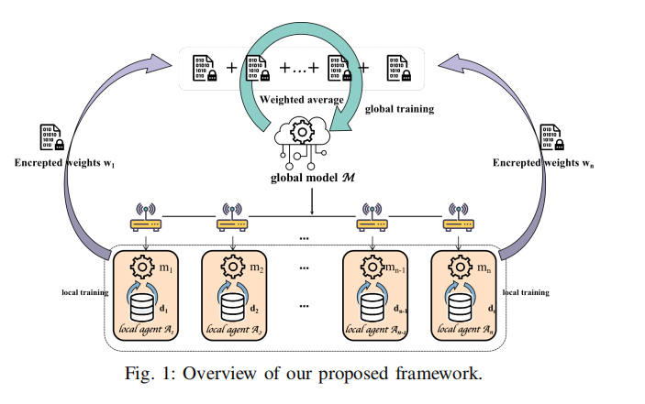
How Federated Learning Works
Local Training: Each participant (device, institution, or node) trains a machine learning model on its own private dataset.
Model Update Sharing: Instead of sharing the raw data, only model parameters (gradients, weights) are sent to a central server.
Aggregation: The central server aggregates the updates from multiple participants to improve the global model.
Model Distribution: The updated global model is sent back to participants for further training, refining the model iteratively.

Slide 5
Why Use Federated Learning for Signature Detection?
Federated Learning (FL) is a groundbreaking approach to machine learning that addresses several challenges posed by traditional centralized learning methods. It is particularly beneficial in scenarios where data privacy, security, and decentralized training are crucial. Here are the key reasons why Federated Learning is essential:
1. Privacy and Data Security
One of the biggest advantages of Federated Learning is that data never leaves the local device or organization. Traditional machine learning methods require collecting and storing data in a central server, which increases the risk of data breaches and privacy violations. FL allows organizations to train models without sharing sensitive data, making it ideal for industries like healthcare, finance, and cybersecurity.
2. Decentralized Data Processing
In many real-world applications, data is distributed across different devices or institutions. Federated Learning enables decentralized training, where each participant can contribute to improving a shared model without transferring raw data. This is particularly useful in large-scale applications where data cannot be easily centralized due to privacy laws, data volume, or infrastructure limitations.
3. Compliance with Data Protection Regulations
With increasing data protection laws such as GDPR (General Data Protection Regulation) and HIPAA (Health Insurance Portability and Accountability Act), organizations must ensure that user data remains private and secure. Federated Learning helps businesses comply with these regulations by keeping data localized while still enabling AI-driven improvements.
4. Reduced Communication Costs
Transmitting large datasets to a central server can be costly and inefficient, especially in environments with limited bandwidth. Instead of sending raw data, FL only transfers model updates (such as gradients or weights), significantly reducing the amount of transmitted information. This makes it ideal for mobile and IoT (Internet of Things) devices.
5. Handling Non-IID Data (Diverse Data Sources)
Traditional machine learning assumes that data is independent and identically distributed (IID). However, in real-world applications, data often varies significantly across different users or devices. Federated Learning allows models to learn from non-IID (non-identically distributed) data, making them more robust and adaptable to real-world scenarios.

Slide 6
Traditional vs Federated Learning Approach
In contrast, Federated Learning enables decentralized training, where data remains on local devices, and only model updates (such as weights or gradients) are shared with a central server. This ensures data privacy, reduces communication costs, and allows personalized AI models. FL is particularly beneficial for applications like healthcare, finance, and mobile AI, where maintaining data confidentiality is crucial.
Machine learning models are typically trained using either Traditional Learning or Federated Learning (FL). Traditional learning follows a centralized approach, where data from multiple sources is collected and stored on a central server for model training. While effective, this method poses serious privacy risks, requires high bandwidth, and struggles with data security issues. Sensitive information, such as medical records and financial transactions, is vulnerable to breaches, making centralized learning less suitable for privacy-sensitive applications.
Additionally, FL handles non-IID data better than traditional learning, making it more adaptable to diverse environments. It also enhances scalability, allowing AI models to improve collaboratively across multiple devices or institutions without violating data privacy regulations.
In conclusion, while traditional learning has been widely used, Federated Learning offers a secure, efficient, and privacy-preserving alternative that is shaping the future of AI. As industries prioritize data security, FL is emerging as the preferred approach for modern machine learning applications.

Slide 7
Signature Detection Techniques
Signature detection is crucial for verifying authenticity in banking, legal, and financial sectors. Techniques are classified into offline (static) and online (dynamic) methods, with modern advancements using machine learning and federated learning.
Offline Detection (for scanned signatures):
  Template Matching – Compares input with stored signature.
  Feature Extraction – Analyzes shape, edges, and stroke thickness.
  Machine Learning Models – Uses SVM, KNN, or Random Forest for classification.
Online Detection (real-time signatures):
  Dynamic Time Warping (DTW) – Tracks stroke speed and pressure.
  Hidden Markov Models (HMM) – Analyzes sequential signature patterns.
  Deep Learning – CNNs and RNNs enhance accuracy.
Federated Learning Approach
  Trains AI models decentrally while preserving privacy.
  Enhances security without transferring raw signature data.

Slide 8
Dataset Considerations
1. Data Type (Offline vs. Online Signatures)
Offline Datasets contain scanned images of handwritten signatures, requiring preprocessing techniques like binarization, noise removal, and feature extraction.
Online Datasets include dynamic features such as pen pressure, stroke speed, and direction, providing richer information for verification.
2. Dataset Size and Diversity
A large dataset with genuine and forged signatures is crucial for model generalization.
Should include signatures from diverse users, writing styles, and cultural variations.
Must account for intra-user variations (natural differences in a person’s signature) and inter-user variations (differences between different people's signatures).
3. Data Labeling and Annotation
Proper labeling of signatures as genuine, skilled forgery, or random forgery is essential.
Skilled forgeries (imitations by professional forgers) should be included to enhance model robustness.
4. Data Augmentation & Preprocessing
Augmentation techniques like rotation, scaling, and distortion help improve model generalization.
Noise reduction, thresholding, and edge detection enhance signature clarity in offline datasets.

Slide 9
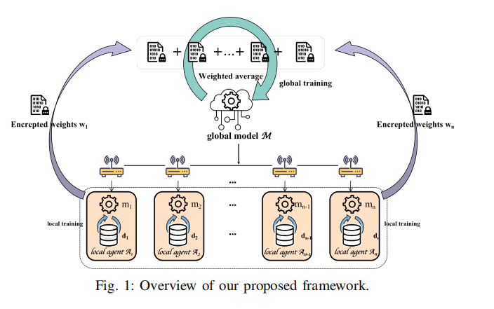
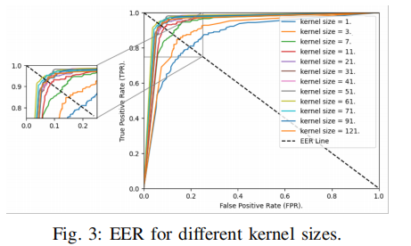
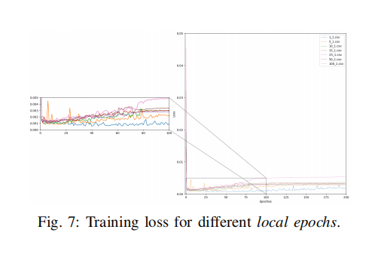
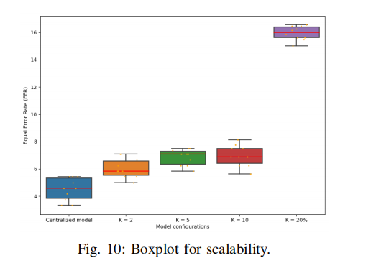

Slide 10
Federated Learning Frameworks
TensorFlow Federated (TFF)
Language: Python
Highlights: Built-in simulation support, works with TensorFlow models, uses Federated Averaging (FedAvg) for aggregation, ideal for research, prototyping, and production.
PySyft
Language: Python
Highlights: Focus on privacy-preserving ML with support for differential privacy, secure multi-party computation, and integration with PyTorch for deep learning.
Flower (FLwr)
Language: Python
Highlights: Flexible and scalable, supports TensorFlow, PyTorch, and Scikit-learn, with customizable aggregation strategies suitable for both simulation and real-world deployments.
FATE (Federated AI Technology Enabler)
Language: Python
Highlights: Designed for enterprise-level federated learning, supports various architectures (horizontal, vertical, transfer learning), and incorporates secure multi-party computation.
PaddleFL
Language: Python
Highlights: Supports large-scale federated learning with deep models, handles heterogeneous training environments, and integrates with PaddlePaddle.

Slide 11
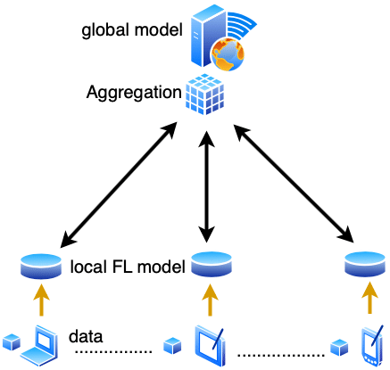
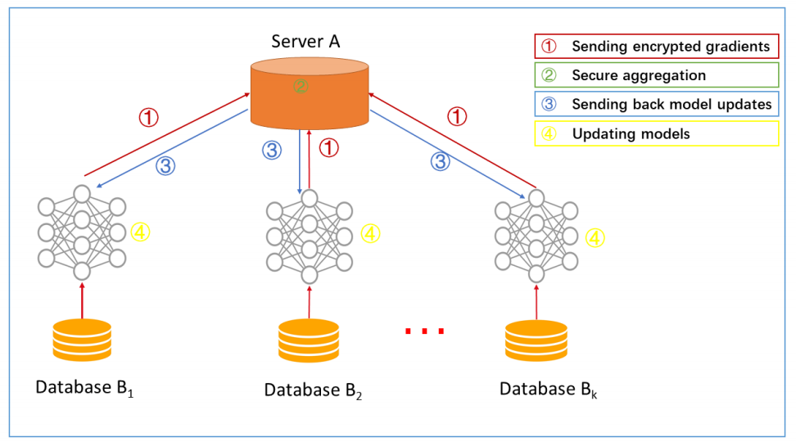
Model Architecture

Slide 12
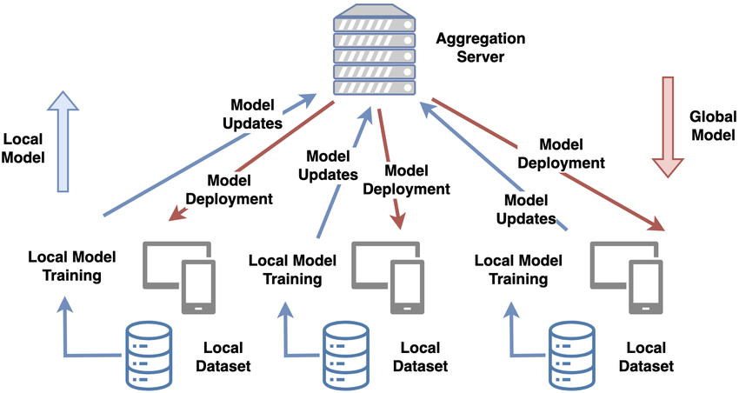
Training Process
1. Data Collection & Preprocessing
Signature samples are stored locally on user devices (e.g., banks, authentication systems).
Data is cleaned, normalized, and augmented (if needed) for better training.
2. Local Model Training
Each device trains a local model using its own signature data.
Training is performed using algorithms like CNNs (Convolutional Neural Networks) or RNNs (Recurrent Neural Networks).
Only model parameters (not raw data) are updated.
3. Model Updates & Aggregation
Trained local models send their updates (gradients, weights) to a central server.
The Federated Averaging (FedAvg) algorithm combines these updates into a global model.
4. Global Model Distribution
The updated global model is sent back to all devices.
Devices continue training with new local data, refining the model iteratively.

Slide 13
Challenges in Federated Learning
1. Data Heterogeneity (Non-IID Data)
Clients have different signature styles, handwriting variations, and image quality.
Some clients may have more data than others, leading to imbalance.
Solution: Techniques like personalized FL and clustering-based aggregation.
2. Communication Overhead
FL requires frequent model updates between clients and the server.
Slow or unreliable networks can affect training efficiency.
Solution: Model compression, quantization, and local updates before transmission.
3. Privacy and Security Risks
Even though raw data isn’t shared, model updates can leak sensitive information (membership inference attacks).
Solution: Differential privacy, secure aggregation, and homomorphic encryption.
4. System Heterogeneity
Clients have different hardware capabilities (e.g., mobile vs. cloud servers).
Some devices may drop out, slowing down training.
Solution: Asynchronous FL and adaptive client selection.

Slide 14
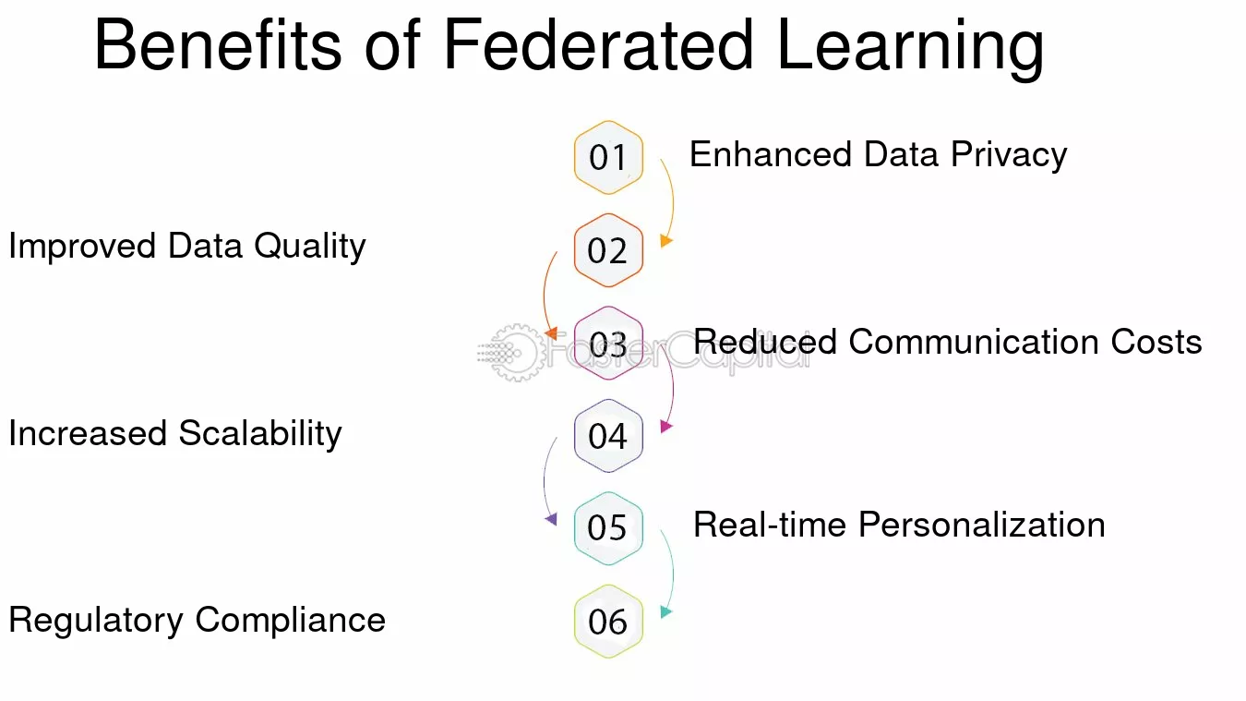

Slide 15
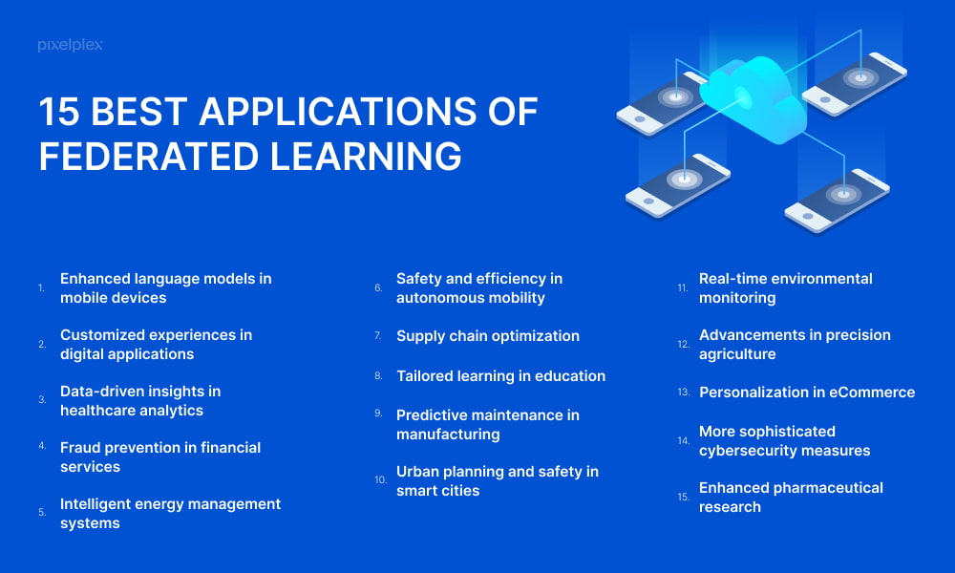

Slide 16
Conclusion and Future Scope
Federated learning for signature detection offers a promising approach to preserving data privacy while enabling collaborative model training across multiple clients. By keeping raw data local and sharing only model updates, this approach mitigates risks related to data security and compliance. Leveraging architectures like CNNs for feature extraction and employing aggregation methods like Federated Averaging ensures a balance between model performance and resource efficiency across diverse, distributed datasets.
Future Scope
Enhanced Privacy Mechanisms: Integrating advanced privacy techniques such as differential privacy, secure multi-party computation, and encryption can further safeguard sensitive data.
Optimized Communication Protocols: Developing more efficient communication strategies will help reduce latency and bandwidth usage during model update exchanges, making the framework more scalable.
Robust Aggregation Methods: Research into novel aggregation algorithms can improve model convergence and performance, particularly in non-IID (non-independent and identically distributed) data scenarios.
Cross-Domain Applications: Extending the federated learning framework to other verification systems or similar pattern recognition tasks can broaden its applicability.
Adaptive and Personalized Models: Future work could explore adaptive models that personalize the global model further based on individual client data, leading to more accurate and user-specific signature verification.

